Slide 1
The Road to Transformers
A journey Through Attention in NLP
C289039 유승환

Slide 2
Introduction
I. The Evolution of NLP and the Emergence of the Transformer
1. Early NLP: Rules, Statistics, and Neural Sequence
2. RNN, LSTM, GRU: Learning from Sequences
3. Seq2Seq Models and Their Limitations
4. The Emergence of the Attention Mechanism
II. Attention Is All You Need (2017)
1. Paper Overview and Motivation
2. Transformer Model Overview
3. Detailed Architecture
III. Trainings & Results
1. Training
2. Experimental Result

Slide 3
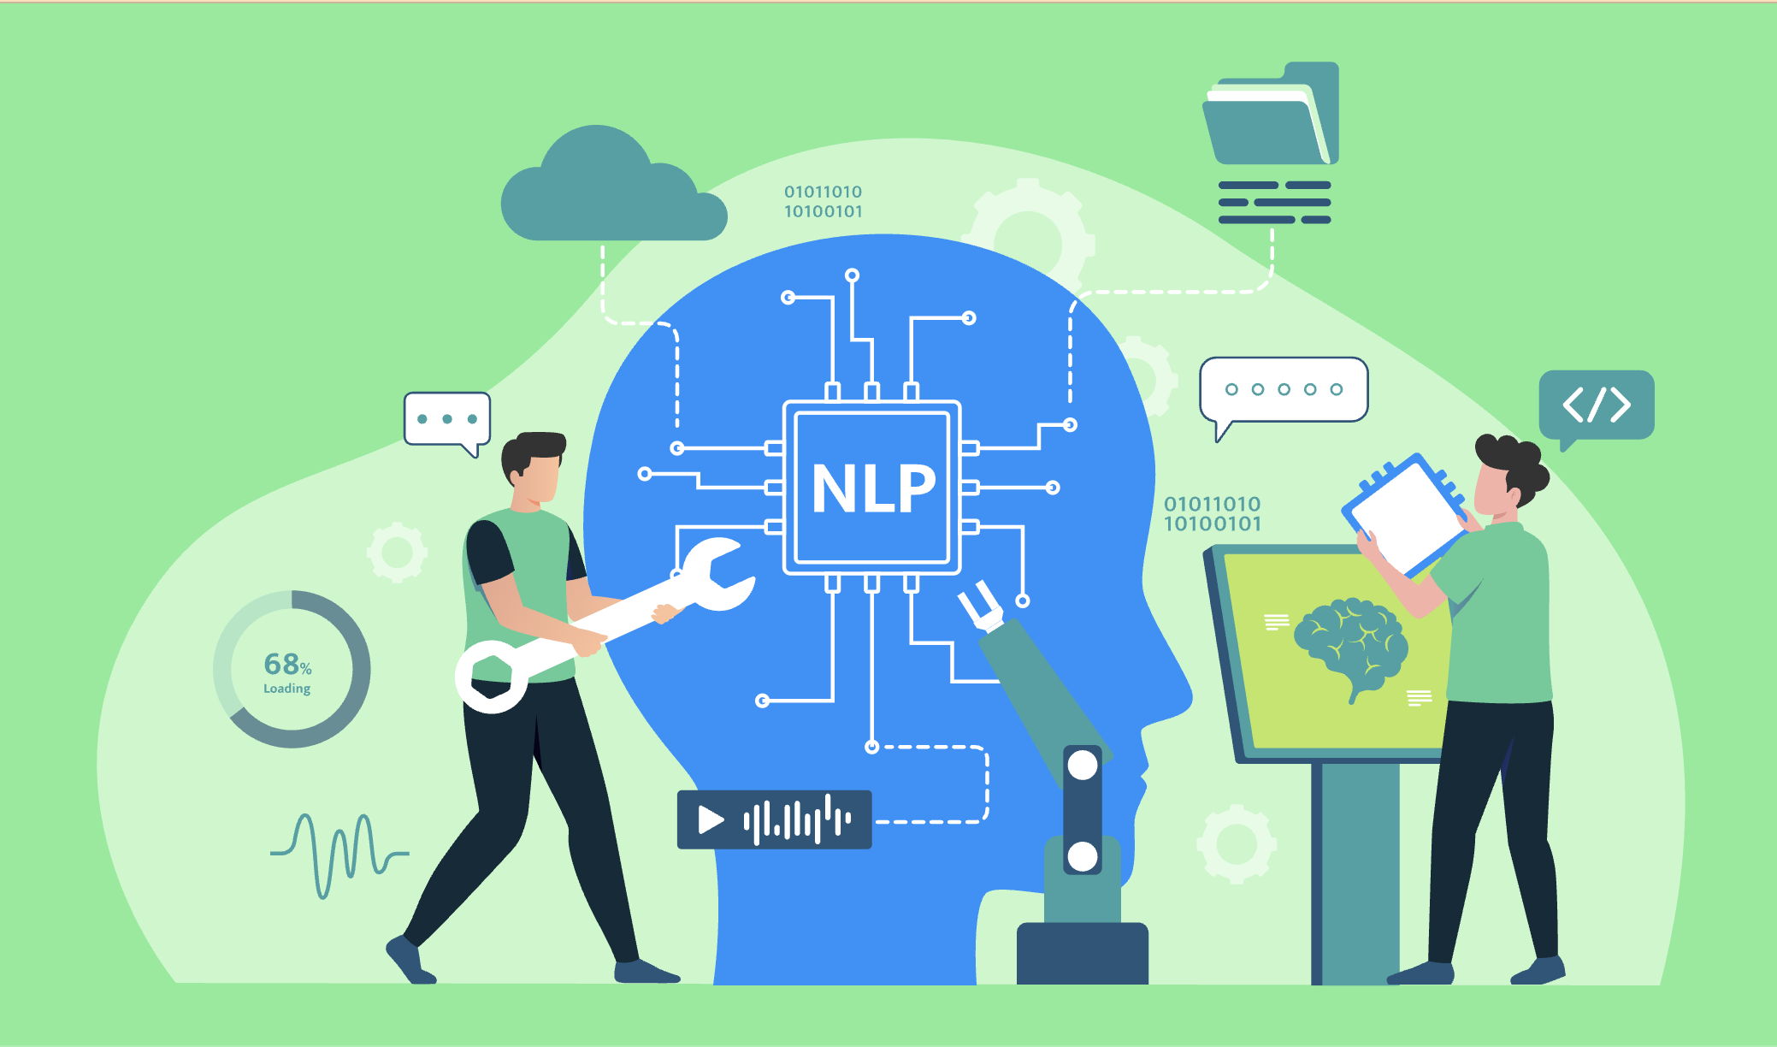
I-1. Early NLP: Rules, Statiscs, and Neural Seq
NLP (Natural Language Processing)
  Understand Structure
  Consider Context
  Interpreting and datafication of Natural Language

Slide 4
I-1. Early NLP: Rules, Statiscs, and Neural Seq
1. Rule-Based
2. Statistical NLP
3.ML Based
4. Neural Sequence Models

Slide 5
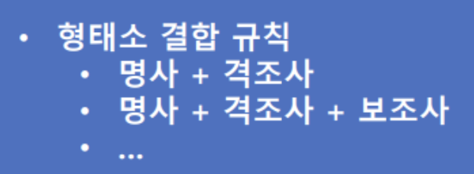
I-1. Early NLP: Rules, Statiscs, and Neural Seq
1. Rule-Based
- Human makes Rule
- Use in Limited Domain
- Limited Scalability
- Unsuitable for Large-scale Datasets

Slide 6
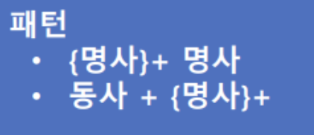
I-1. Early NLP: Rules, Statiscs, and Neural Seq
2. Statistical NLP
- Pattern Modeling
- Limited Context Consideration
- Limited Scalability
- Difficulty Handling Rare Words & Polysemy

Slide 7
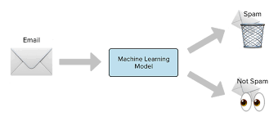
I-1. Early NLP: Rules, Statiscs, and Neural Seq
3. ML Based NLP
- Manual Feature Engineering
- Algorithm-Driven Processing
- Limeted Context Understanding

Slide 8
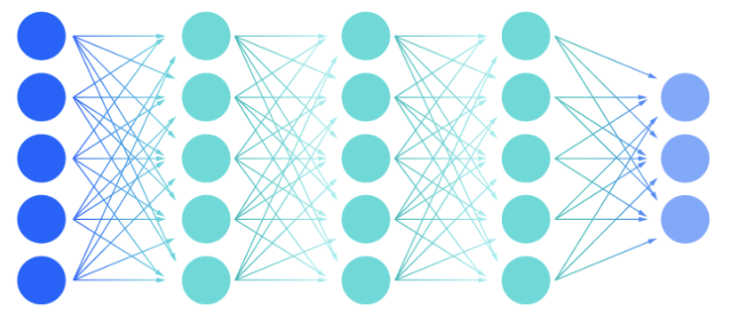
I-1. Early NLP: Rules, Statiscs, and Neural Seq
4. Neural Sequence Based
- Automatic Feature Learning
- Improved Contextual Understanding

Slide 9
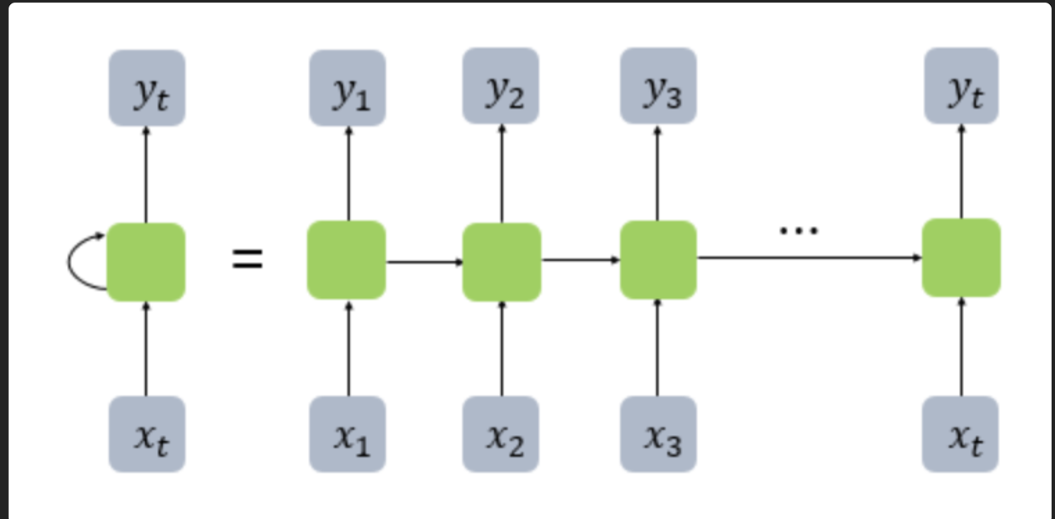
I-2. RNN, LSTM, GRU: Learning from SEQ

Slide 10
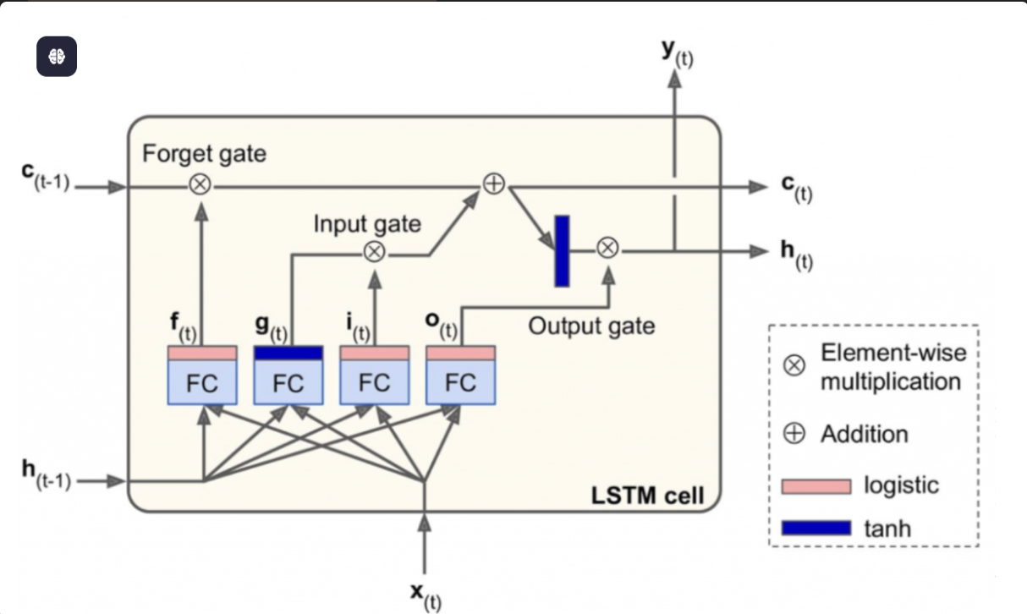
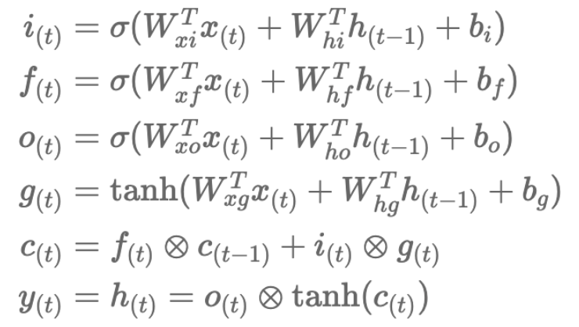
I-2. RNN, LSTM, GRU: Learning from SEQ

Slide 11
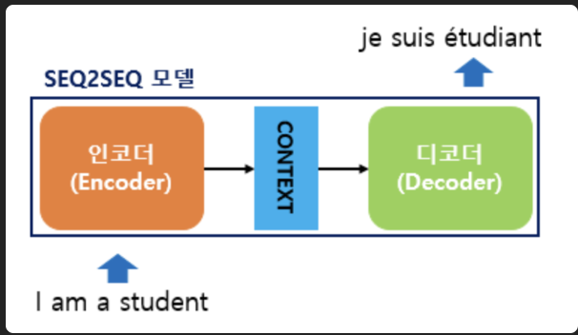
I-3. Seq2Seq

Slide 12
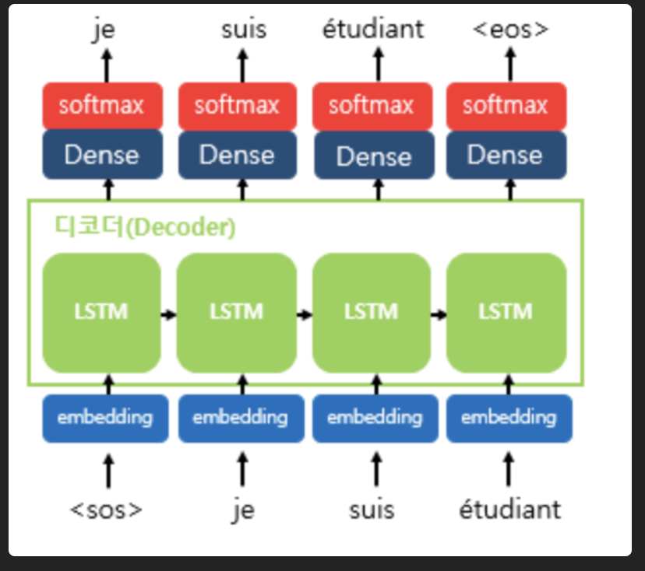
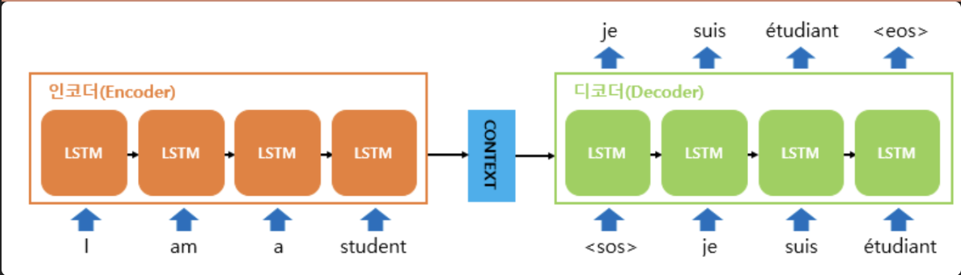
I-3. Seq2Seq

Slide 13
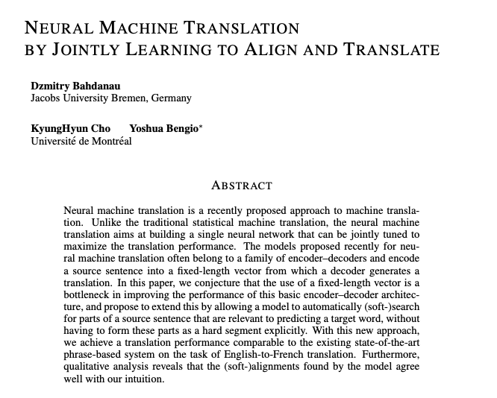
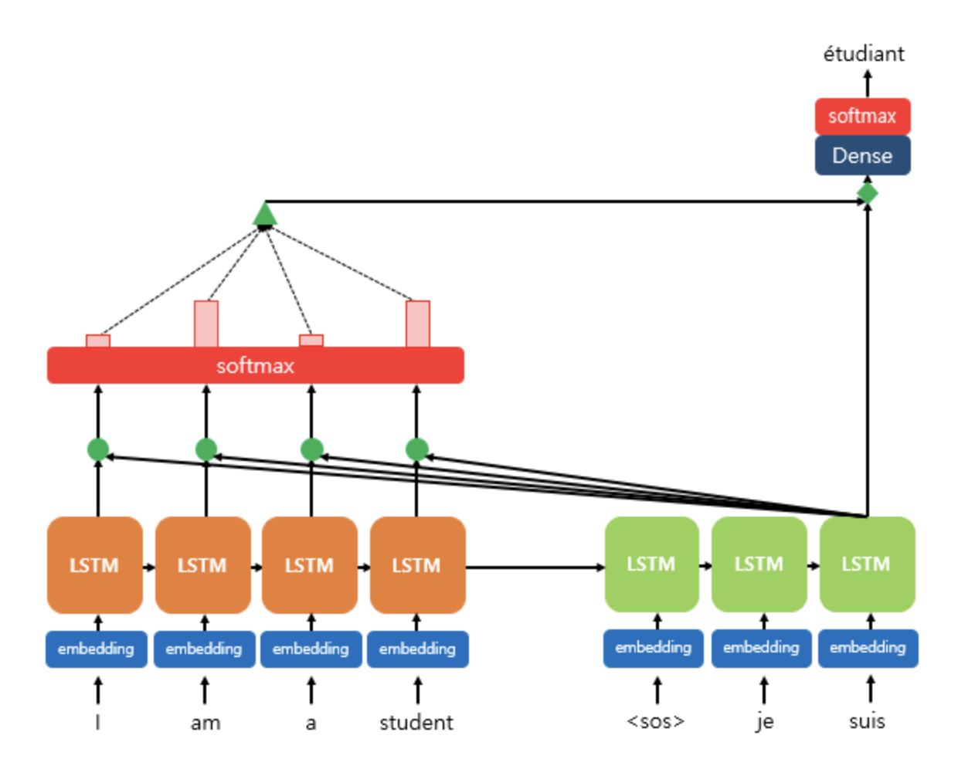
I-4. The Emergence of Attention

Slide 14
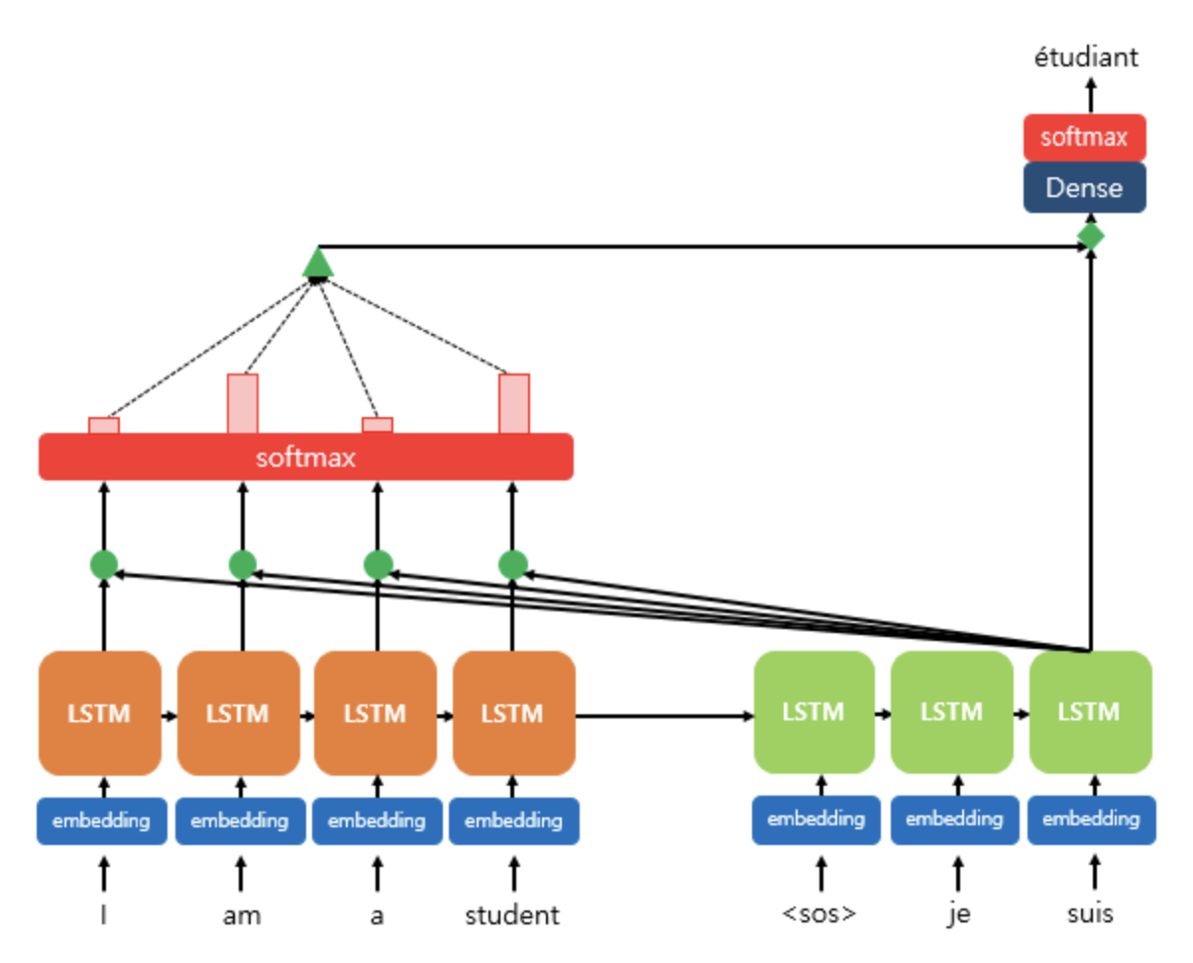

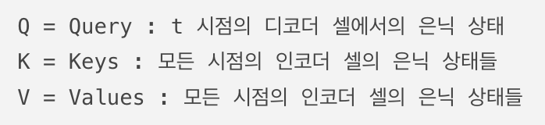
I-4. The Emergence of Attention
Dot-Product Attention

Slide 15


I-4. The Emergence of Attention
Step 1. Calculate Attention Score
a = 디코더의 은닉 상태 · 인코더의 모든 은닉상태

Slide 16
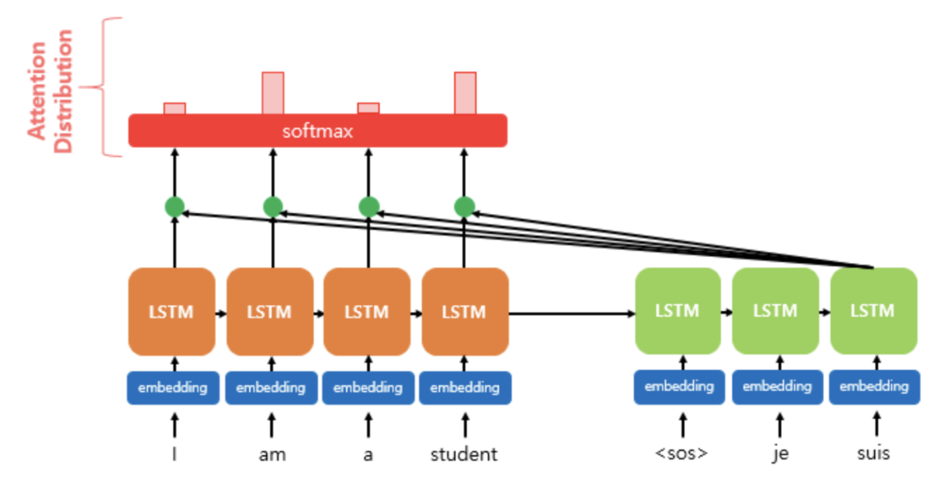
I-4. The Emergence of Attention
Step 2. Calculate Attention Distribution

Slide 17
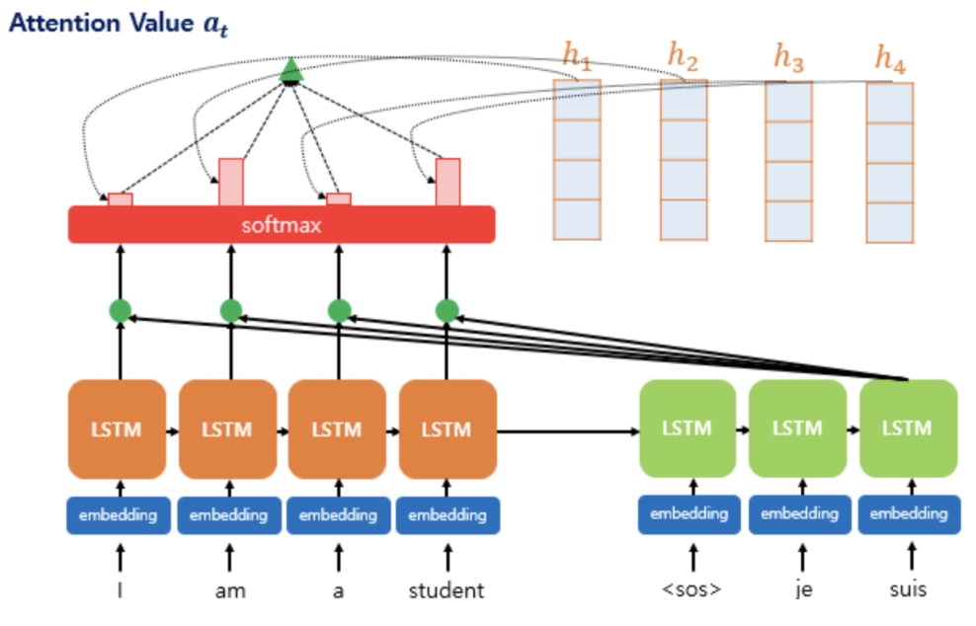
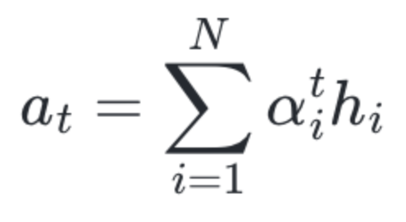
I-4. The Emergence of Attention
Step 3. Calculate Attention Value

Slide 18
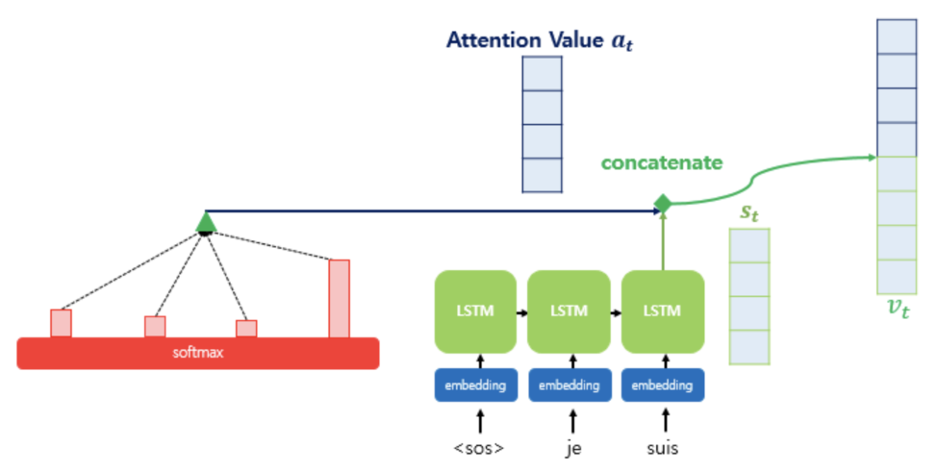
I-4. The Emergence of Attention
Step 4. Concatenate Attention Value & Hidden State

Slide 19
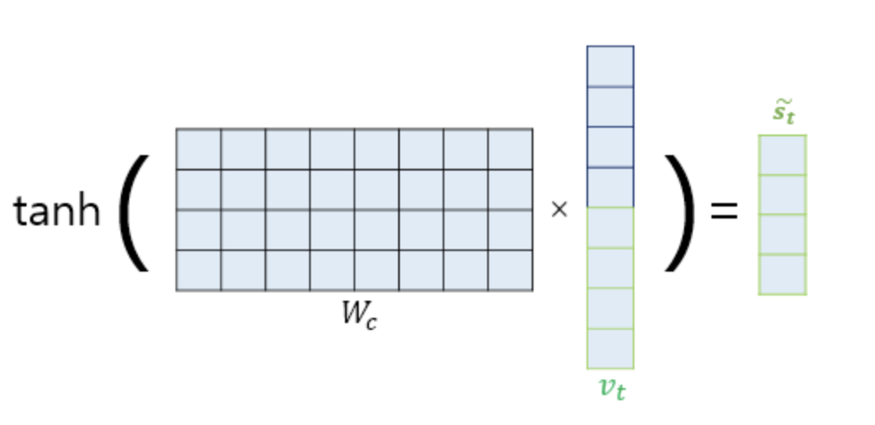
I-4. The Emergence of Attention
Step 5. Adjust Input

Slide 20
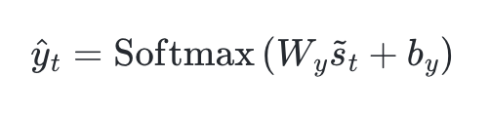
I-4. The Emergence of Attention
Step 5. Calculate Output Vector

Slide 21
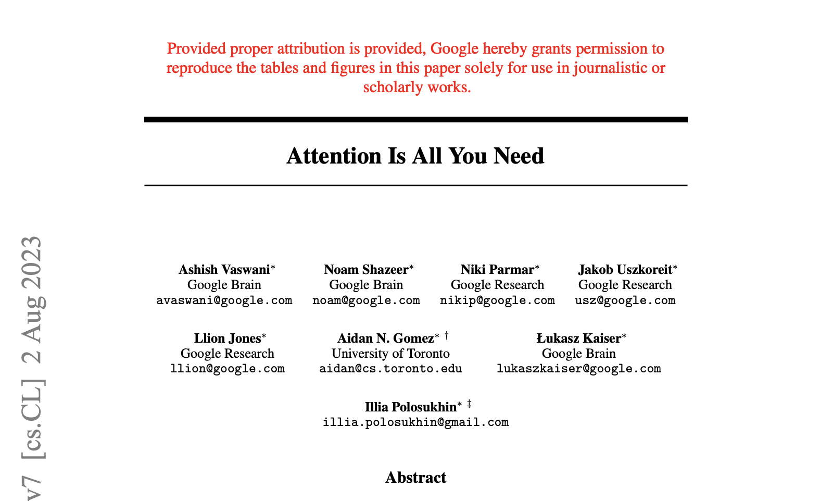
II. Attention is All you Need (2017)

Slide 22
II-1. Paper Overview and Motivation
Recursive Model
순차적 특성으로 인해 훈련에서의 병렬화 불가
시퀀스의 길이가 길어질 수록 훈련 효율성 Down
기존 해결 방법은 순환 모델의 한계를
해결 X
CNN Model
병렬화 계산 가능
먼 위치 간의 의존성 학습이 어려움
-> 연산 횟수를 상수로 줄여 해결
Attention Weight 해상도 감소 문제
-> Multi Head Attention 적용

Slide 23
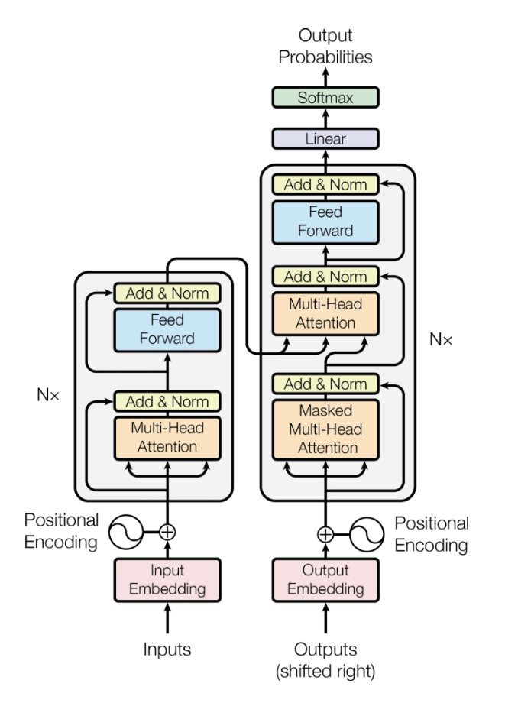




II-3. Transformer Model Overview
Hyper Parameter

Slide 24
II-3. Transformer Model Overview

Slide 25
II-3. Detailed Architecture
Positional Encoding

Slide 26
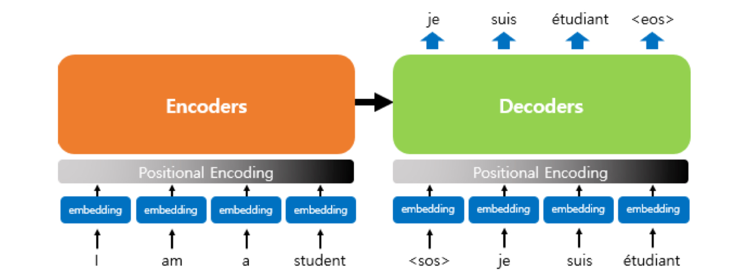
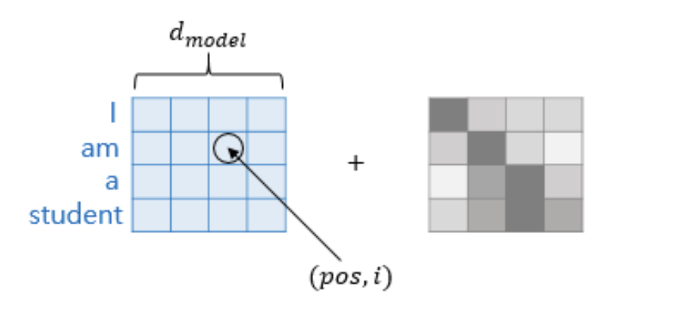
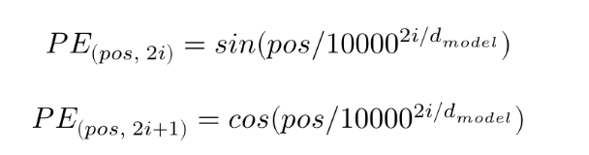
II-3. Detailed Architecture
Positional Encoding

Slide 27
II-3. Detailed Architecture
Multi-Head-self-AttentionLayer

Slide 28
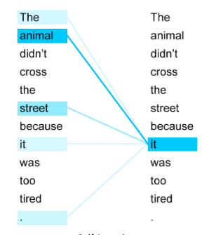
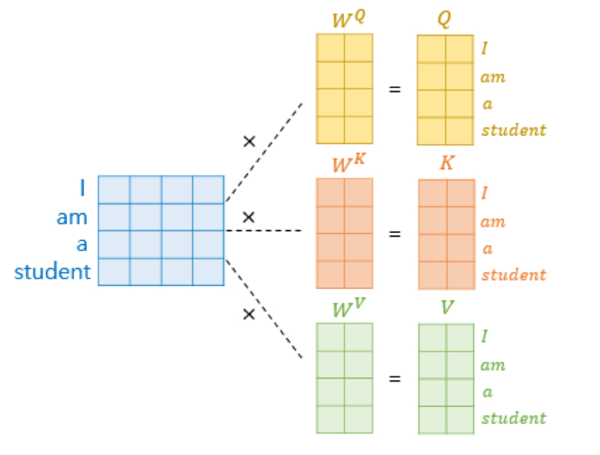
II-3. Detailed Architecture
Self-Attention

Slide 29
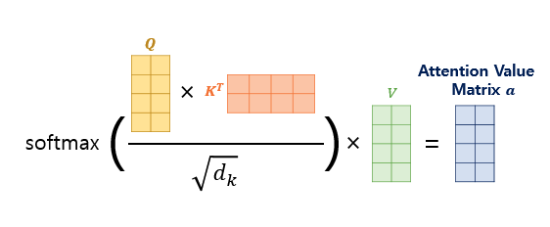
II-3. Detailed Architecture
Scaled-Dot-Product Attention

Slide 30
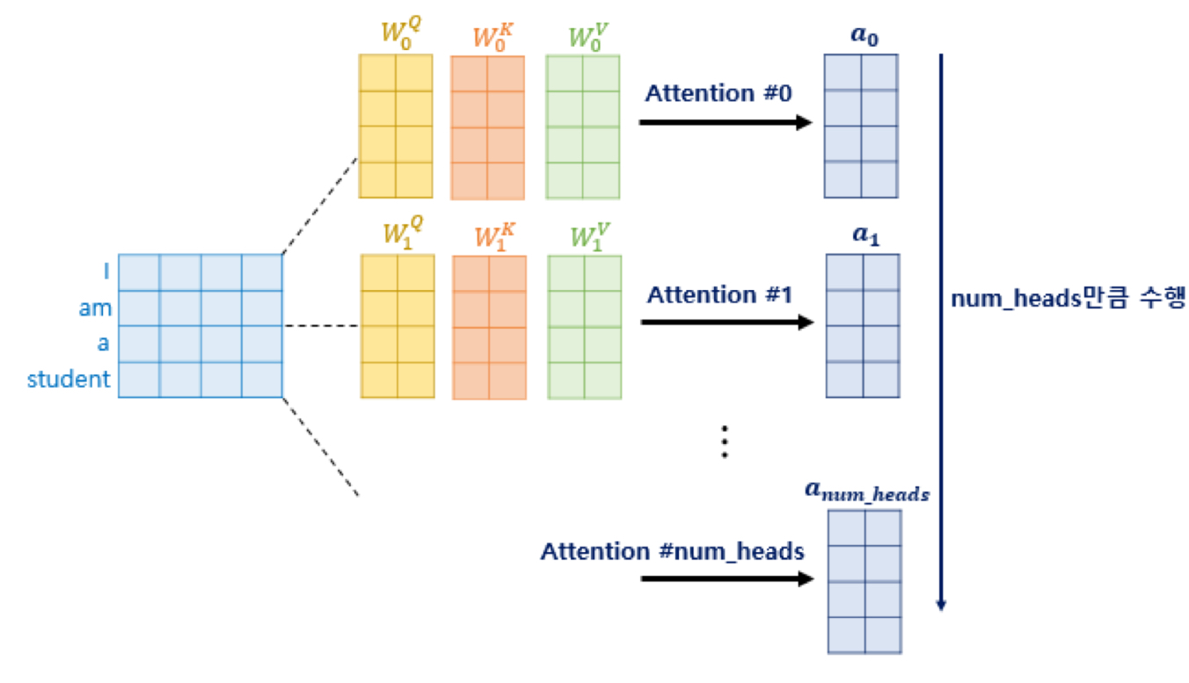
II-3. Detailed Architecture
Multi-Head Attention

Slide 31
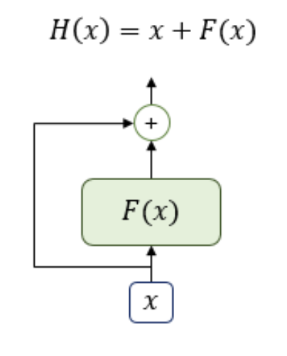

II-3. Detailed Architecture
Residual Connection & LayerNormailization

Slide 32
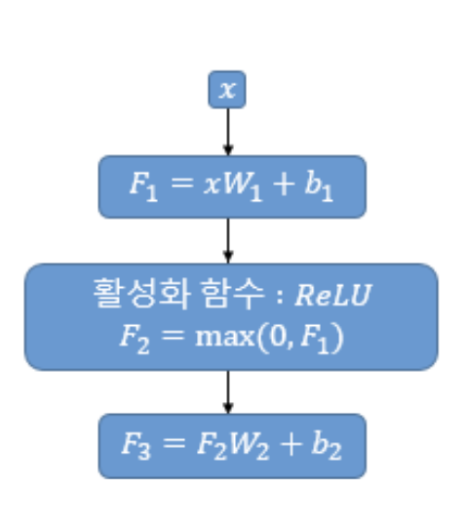

II-3. Detailed Architecture
Position-wise FFNN

Slide 33
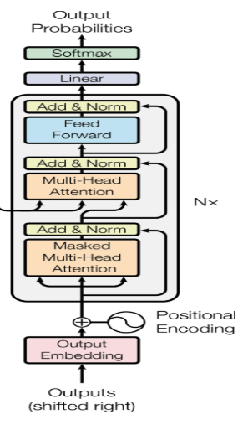
II-3. Detailed Architecture
Look-ahead Mask

Slide 34
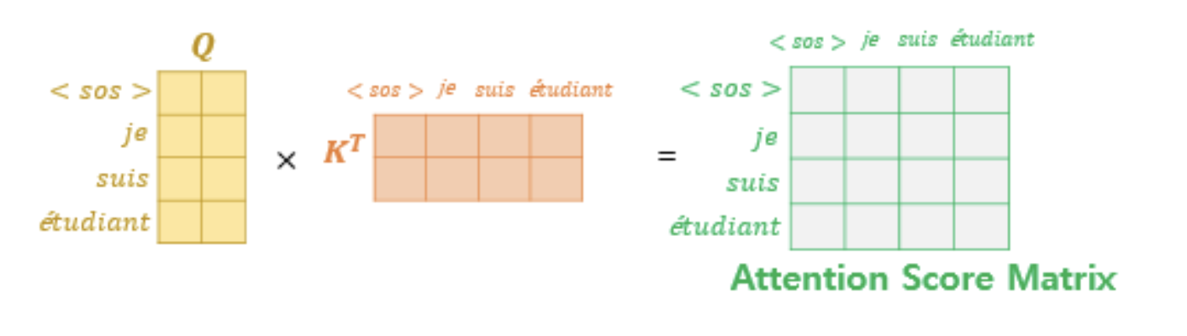
II-3. Detailed Architecture
Look-ahead Mask

Slide 35
II-3. Detailed Architecture
Look-ahead Mask

Slide 36
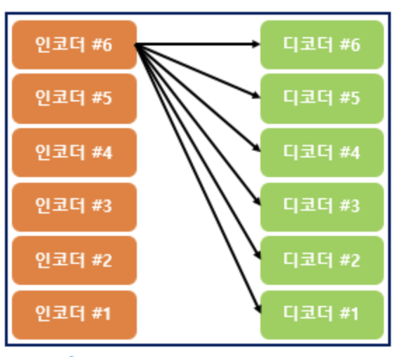
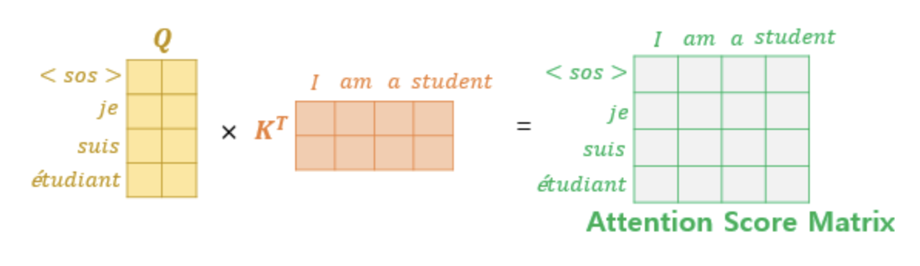
II-3. Detailed Architecture
Encoder-Decoder Multi-Head Attention

Slide 37
III-1. Training
Calculate Loss with Cross-Entropy
0.9 | 0.01 | 0.01 | 0.01 | 0.00
0.01 | 0.00 | 0.9 | 0.00 | 0.00
0.00 | 0.01 | 0.00 | 0.00 | 0.9
0.01 | 0.00 | 0.00 | 0.9 | 0.00

Slide 38
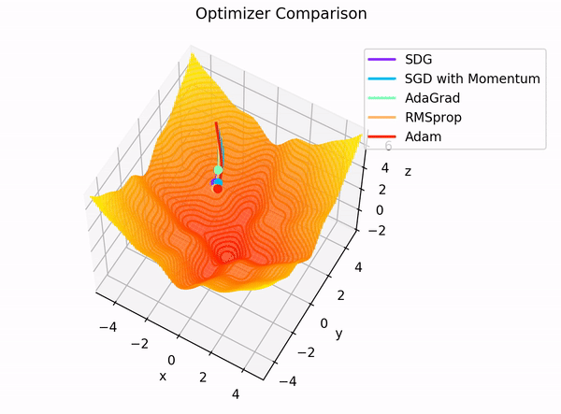
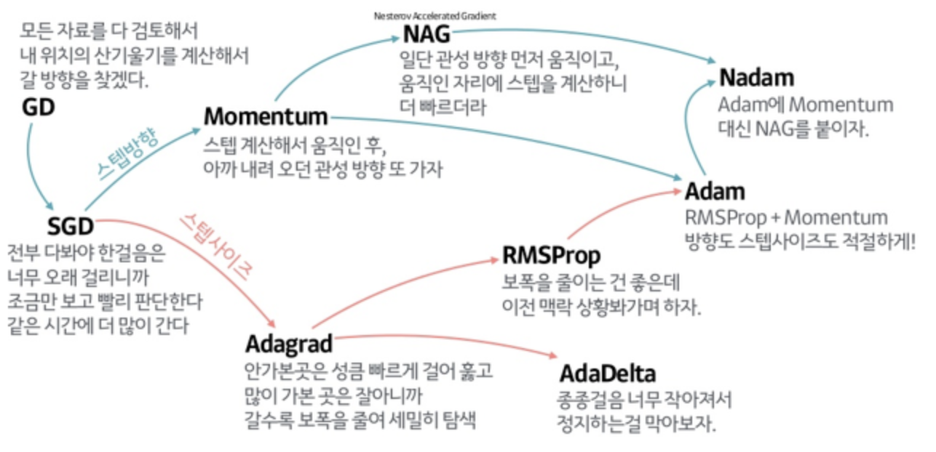
III-1. Training
Adam-Optimizer

Slide 39
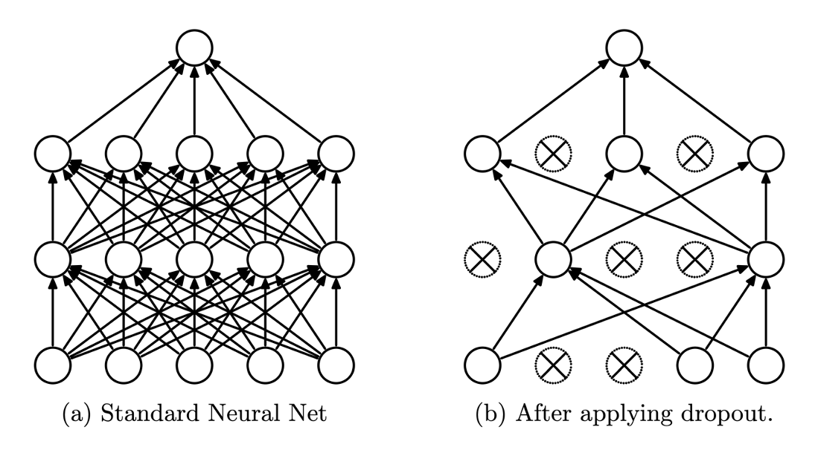
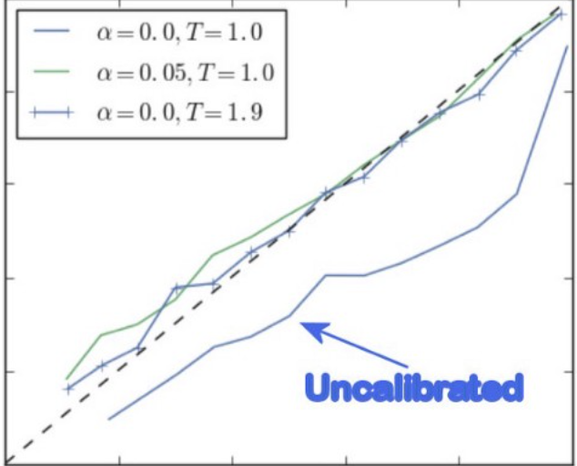

III-1. Training
Regulization
Drop-Out
Label-Smoothing

Slide 40
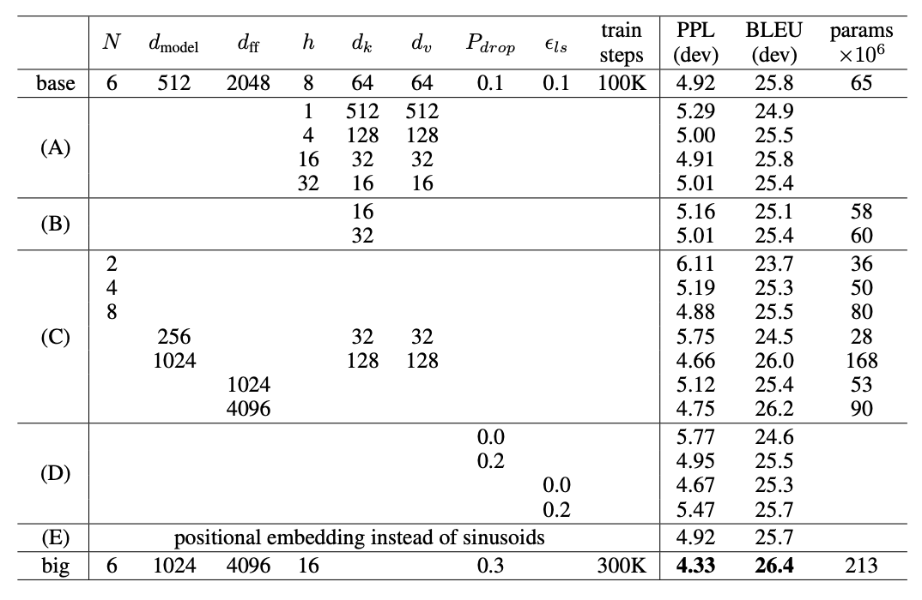
II-4. Experimental Results

Slide 41
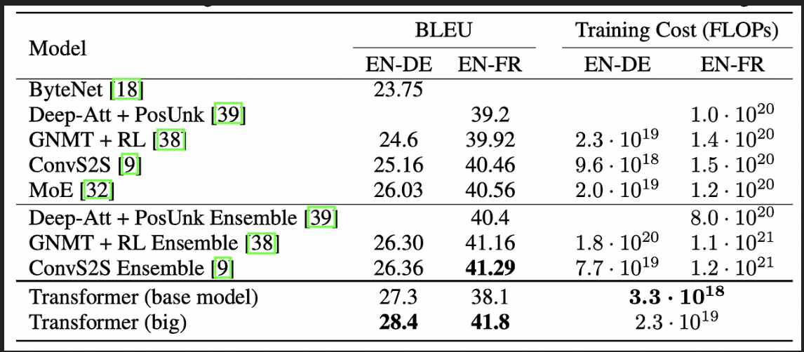
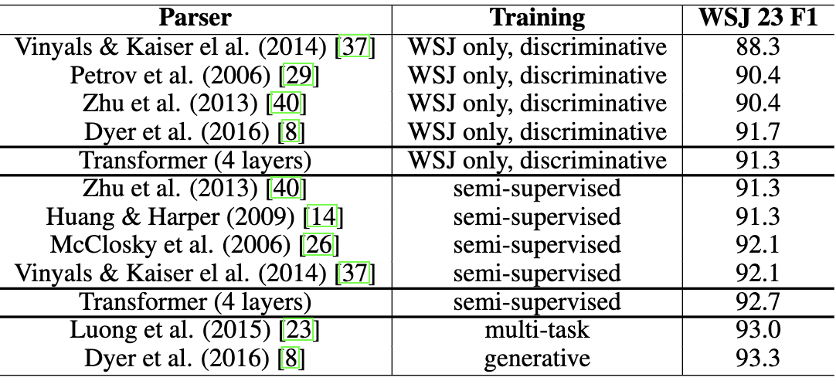
II-4. Experimental Results

Slide 42
감사합니다.
참고자료
3b1b - 딥러닝 시리즈
위키독스 - 딥러닝을 이용한 자연어 처리 입문
Attention is all you need (2017)
핸즈온 머신러닝

